Slide 1
Library Database

Slide 2
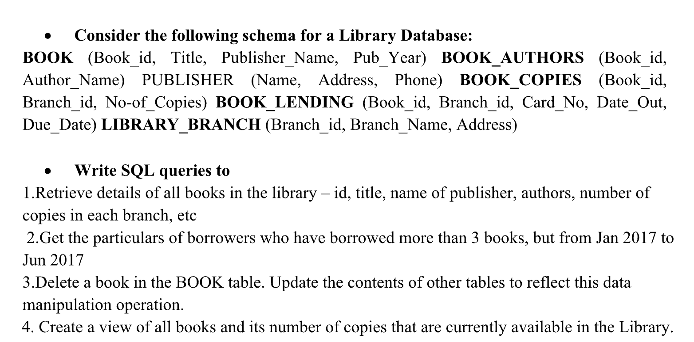

Slide 3
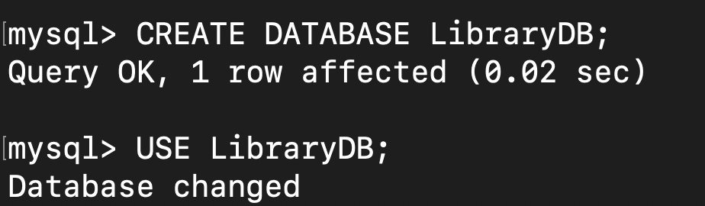
Order of table creation :
BOOK
BOOK_AUTHORS
PUBLISHER
BOOK_COPIES
LIBRARY_BRANCH
BOOK_LENDING

Slide 4
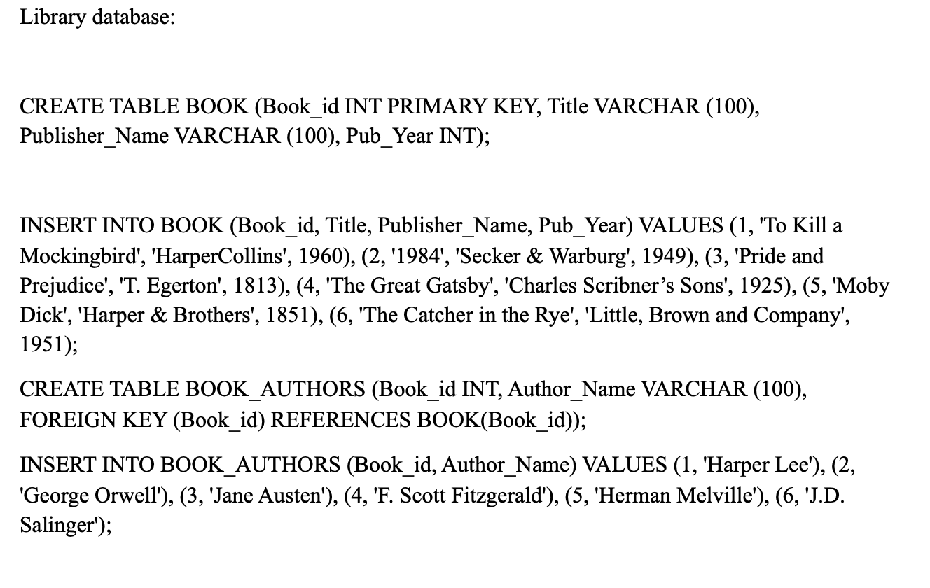

Slide 5
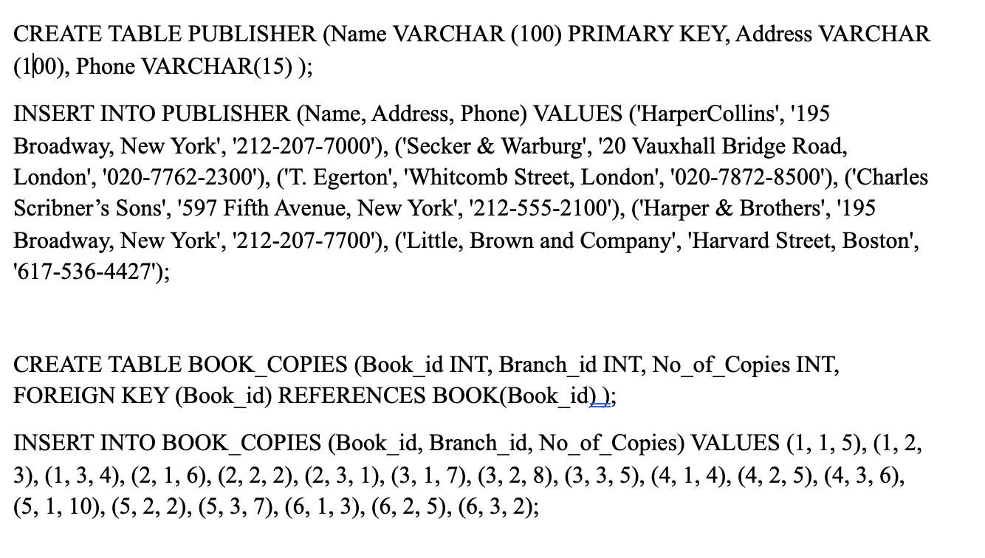

Slide 6
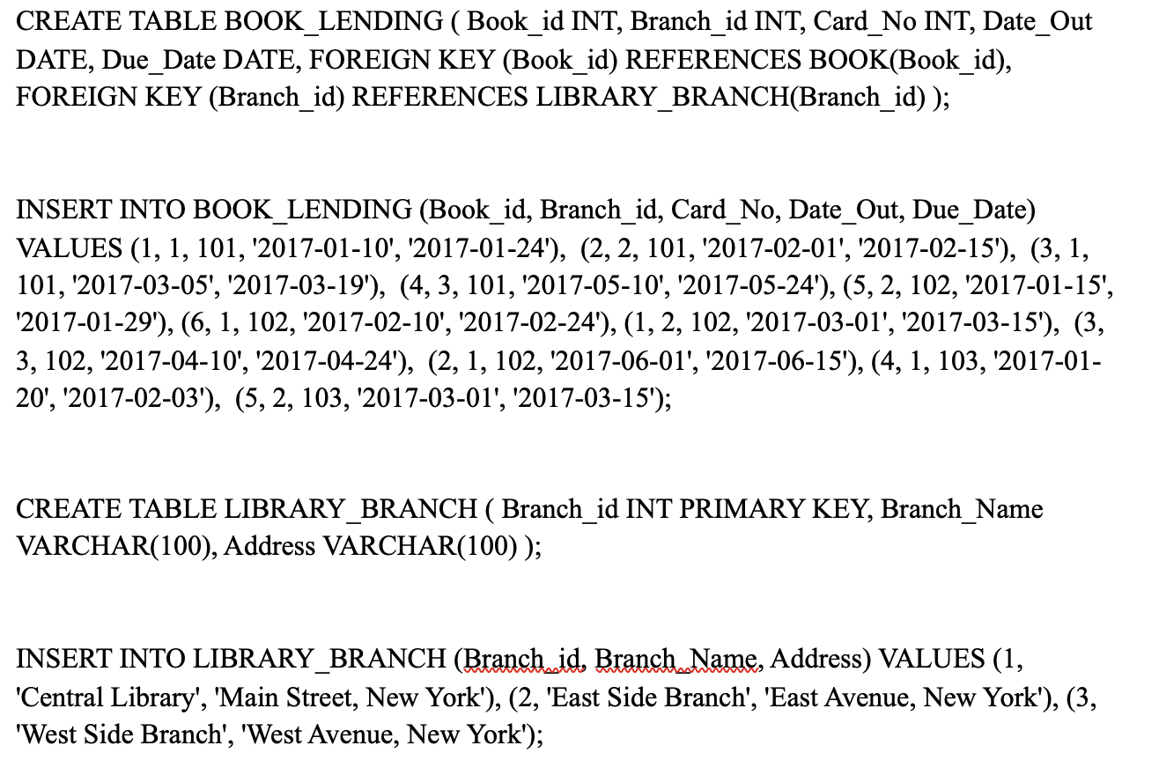

Slide 7
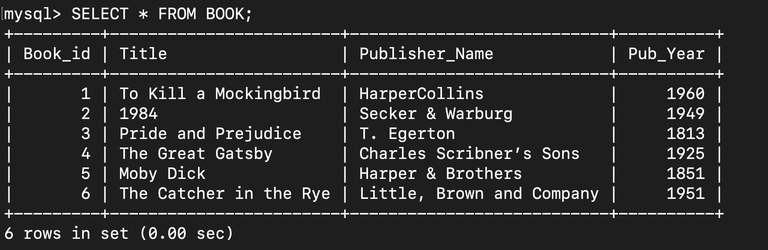

Slide 8
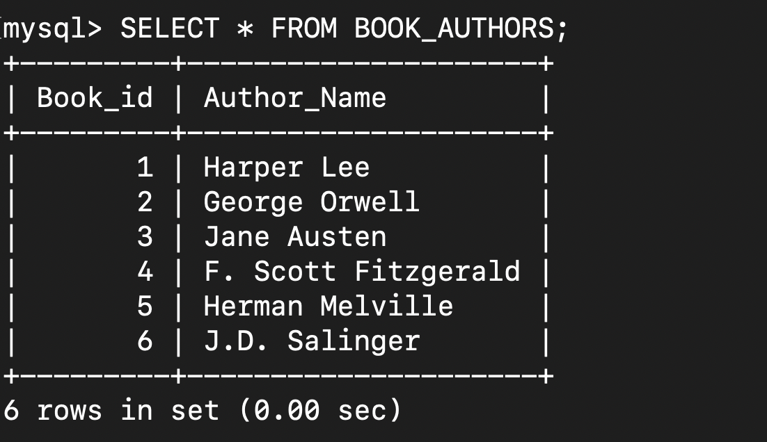

Slide 9
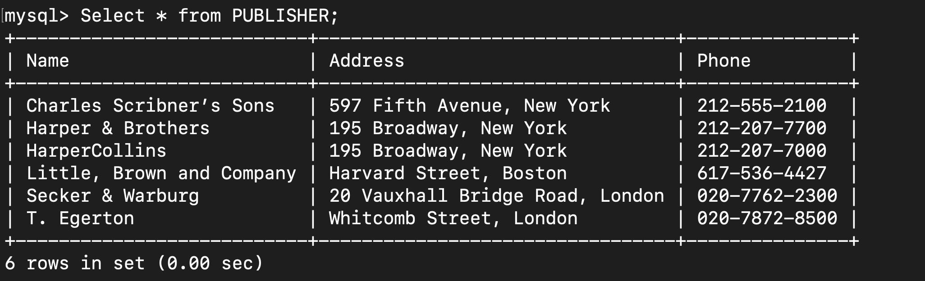

Slide 10
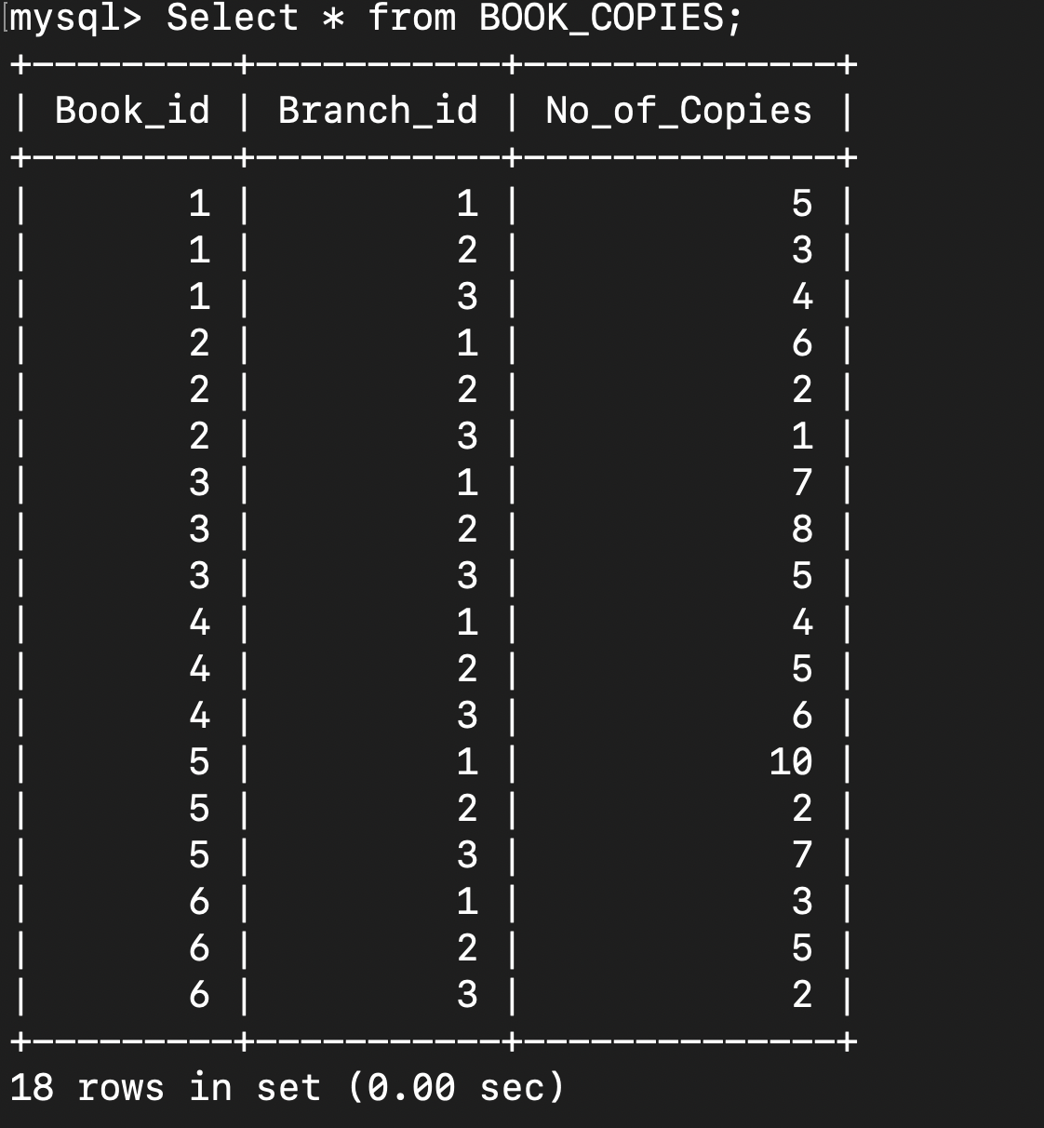

Slide 11
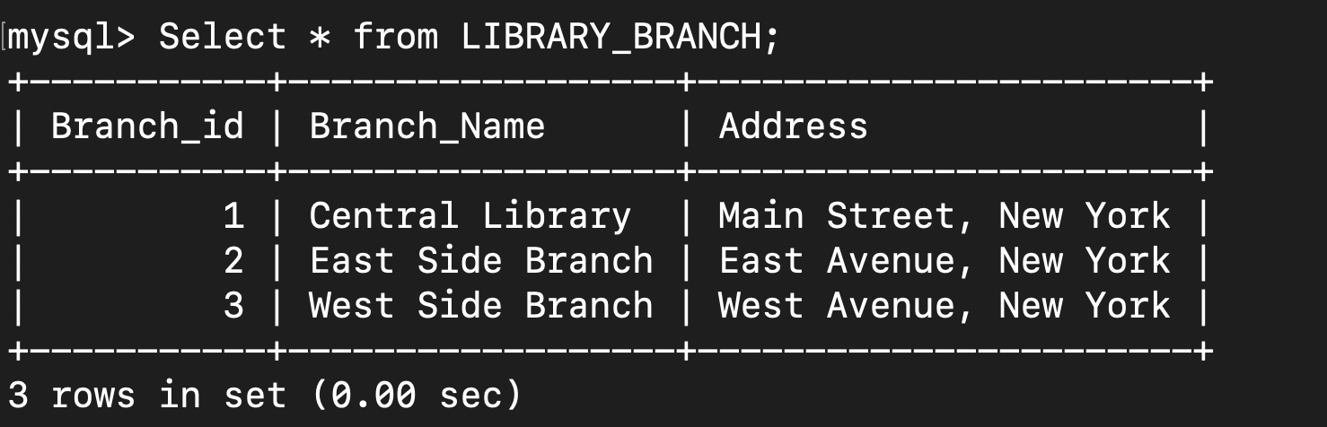

Slide 12
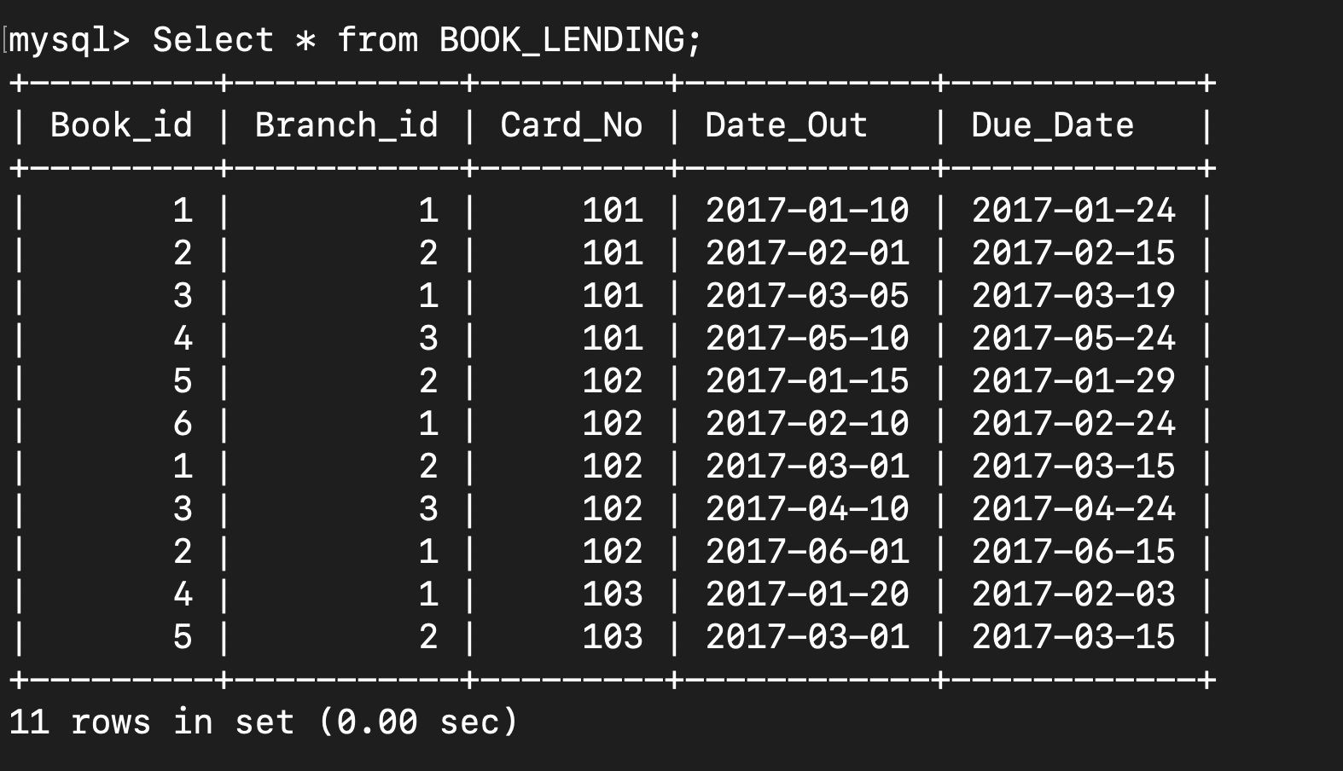

Slide 13
INSERT INTO PUBLISHER (Name, Address, Phone) VALUES
('HarperCollins', '195 Broadway, New York', '212-207-7000’),
('Secker & Warburg', '20 Vauxhall Bridge Road, London', '020-7762-2300’),
('T. Egerton', 'Whitcomb Street, London', '020-7872-8500’),
('Charles Scribner’s Sons', '597 Fifth Avenue, New York', '212-555-2100’),
('Harper & Brothers', '195 Broadway, New York', '212-207-7700’),
('Little, Brown and Company', 'Harvard Street, Boston', '617-536-4427’);
INSERT INTO BOOK_LENDING (Book_id, Branch_id, Card_No, Date_Out, Due_Date) VALUES
(1, 1, 101, '2017-01-10', '2017-01-24'),
(2, 2, 101, '2017-02-01', '2017-02-15'),
(3, 1, 101, '2017-03-05', '2017-03-19'),
(4, 3, 101, '2017-05-10', '2017-05-24’),
(5, 2, 102, '2017-01-15', '2017-01-29’),
(6, 1, 102, '2017-02-10', '2017-02-24’),
(1, 2, 102, '2017-03-01', '2017-03-15'),
(3, 3, 102, '2017-04-10', '2017-04-24'),
(2, 1, 102, '2017-06-01', '2017-06-15’),
(4, 1, 103, '2017-01-20', '2017-02-03'),
(5, 2, 103, '2017-03-01', '2017-03-15');

